Slide 1


How to Get a Job in Sports Analytics Module 6
Dr. Dave Schrader
Teaching Module For Teradata University Network
Send Questions or Comments to drdaveschrader@gmail.com

Slide 2
This is Module 6
There are two versions of the materials
You can pull the “Overview Deck” which has all the slides in one place
Or – you can access 6 modules that carve the material up
#1 – Sports is Big Business
#2 – Sports Analytics is HOT
#3 – Sports Analytics for Business Operations
#4 – Sports Analytics for Team Operations
#5 – Sports Analytics for Training, Health, and Safety
#6 – How to Get a Job in Sports Analytics

Slide 3
How to Get a Job in Sports Analytics? Topic 6
Reality check: most pro analytics staffs are small and really, really hard to get into. You may be able to find a position with your university to start.
3 other employment options
Big media orgs: ESPN Stats and Analytics Team
Companies that do a lot of advertising in sports venues – another way into the mix, e.g., AT&T
Get a job with tech vendors
Wearables: Catapult, Zebra, Nike, Athos
Consulting: Booz Allen Hamilton, SAP
Tech - stats and visualizations: Tableau, SAS
See: ESPN Jobs at http://www.cba.uc.edu/or_sports/ESPN%20SpORts%20Positions.pdf
Notes:
Module 6 – How to Get a Job in Sports Analytics (PowerPoint)
Provided by Dr. Dave Schrader, drdaveschrader@gmail.com
Motivation: Many students are interested in sports analytics but don’t know what they need to learn, or what they could do on their own to make themselves employable. This module provides numerous tips.
The educational goals for this module include:
Students should know what publications and online websites to read so they learn what teams are doing.
Students should know about the leading conferences and access videos and research papers connected to those organizations.
Students should have an idea of what internship opportunities exist.
Students should be realistic about job prospects working for pro teams
The harsh reality (and you can do the math) is that there are limited number of pro teams, that each hires only a few analytics people each year (plus interns) and the supply of students who are interested far exceeds the number of openings. So one goal is to not to dash their hopes but to point out there is an entire eco-system of job possibilities outside of joining a pro team. The list includes the media/broadcast companies who need insights to make their announcers/graphics more interesting (think ESPN), the advertisers who are interested in business operational items like media buy payoffs and ad placement/sponsorship returns, as well as the existing and emerging tech industries that provide vendor jobs to sell products and services to the teams. With wearables well in use for the pros, the next market will be selling to colleges (and even high schools). So this slide gives a quick overview of the job possibilities.

Slide 4
What Can You Do To Increase Your Odds
Get smart on the state of the art for sports analytics
Read sports websites, learn what people are doing
Watch sports analytics videos
Access and play around with sports data sets
Attend conferences or join sports analytics associations
Research what tech vendors are doing
Try to get an internship
Pick a specialty area and “go deep”
Notes:
this is a list of the topics in this module

Slide 5








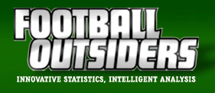

Read Sports Websites, Online Blogs, Journals
Source: Double click on any of the above to go the associated websites
Notes:
these are some of the key (mostly free) websites that students can access to get in the habit of reading something about sports analytics on a daily basis. The links are “hot”, meaning you can click on them to open up a web browser to see what each offers.

Slide 6
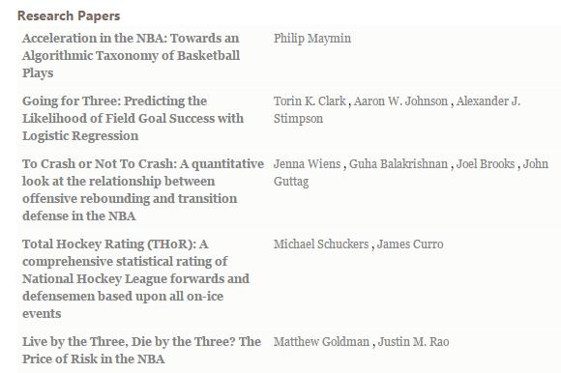
Read! Online Research from MIT
There are several interesting research papers online. Just Google the terms along with MIT SSAC. You can go back multiple years.
An interesting one from the 2014 show is on “Achievement Metrics”, in which the authors analyzed text transcripts of the interviews of athletes – and tried to predict which NFL players would be arrested or suspended. Turns out those people speak “differently”. http://www.sloansportsconference.com/?p=621
Source: http://www.sloansportsconference.com
Notes:
the MIT Sloan Sports Analytics Conference organizers publish many of the research papers, which provide a good survey of the academic state of the art of working with the teams. Students may want to look at papers on this list as they “go deeper” in a particular sport, or go find additional research papers from earlier conference years.

Slide 7
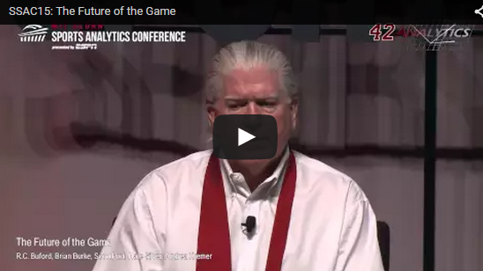
Watch Videos on YouTube
Many 1 hour videos from the various MIT Sloan Sports Analytics Conference). Search “MIT SSAC” on YouTube. One of the best:
Future of the Game – see link below
Source: https://www.youtube.com/watch?v=XfqMn3Dg-aE
Notes:
MIT SSAC has also put up a subset of the videos on YouTube. There are 2 that I highly recommend – the one on this page is an hour long panel from the end of the conference, but in addition to the key points, the speakers are all “big deals” in their respective sports areas, and also very personable and entertaining (and sometimes foul-mouthed). Watching this will give you (and students) a good idea of what’s coming. The other video is from the previous year’s event and provides a good example of how text analytics can be used to predict jail time!

Slide 8
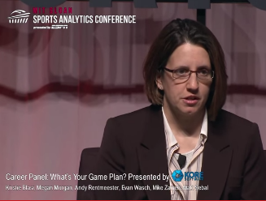
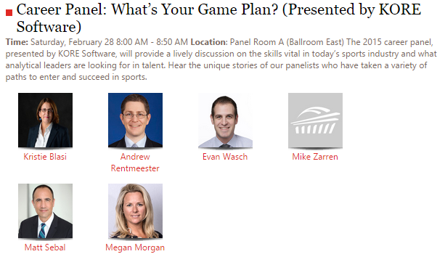
Watch the MIT Career Panel Excellent Career Tips
ESPN hires many people. Kristie explains how they interview
Various backgrounds can work!
Storytelling is a key skill – it’s not just about the stats, but how the stats fit into the context of the game
“Passion is key, but you must bring something extra to the table …”
Blasi – EPSN Stats and Analytics
Rentmeester – New York Knicks
Wasch – NBA
Zarran – Celtics
Sebal – KORE SW
Morgan – American Athletic Conf
Source: : https://www.youtube.com/watch?v=48tZGURQsOM
Notes:
this MIT panel video is an excellent wrap-up for this module, since it involves people who are leaders who explain how they got their jobs. Often, this is not by studying stats. For example, Kristie Blasi, who heads a 200 person group at ESPN doing analytics, has a journalism background. “You have to be able to wrap a story around the data” is one of her key points, and that’s what she interviews for. This is must-see video you can assign as a homework assignment.

Slide 9
Access and Try Out Sports Data Sets
Baseball http://baseballsavant.com/pitchfx_search.php
Basketball http://basketballvalue.com/
Football www.armchairanalysis.com
Hockey www.rinkstats.com http://www.nhl.com/stats/advancedstats
Soccer http://www.jokecamp.com/blog/guide-to-football-and-soccer-data-and-apis/
General http://datahub.io/dataset?q=sports
Notes:
another way for students to learn what’s possible is to tap into existing sports databases. The baseball one provides a query tool. We are going to work to augment this list with more databases from universities as more faculty work with their sports teams (can you help on this?)

Slide 10

Join Sports Analytics Associations They have journals and put on conferences
Source: :https://www.nassm.com/
Notes:
As you might imagine, there are many, many organizations and conferences held by people working in different aspects. The one highlighted here is a key group doing Sports Management, which is a superset of Sports Analytics. You might want to skip this slide but it’s probably important for students to take a look so they can see the wide variety of topics covered. Similarly, there is an entire world of Sports Medicine conferences. They key point is to open the students’ eyes to these other possibilities.

Slide 11
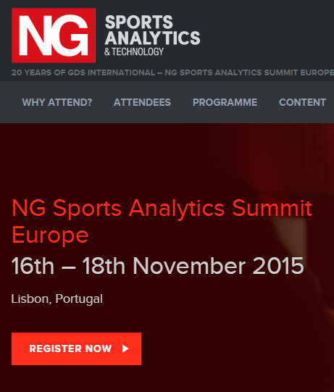
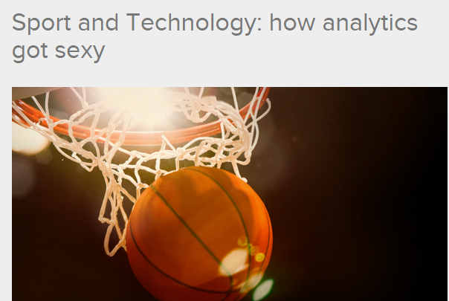
Attend Conferences : Europe
Notes:
Here’s the next upcoming Europe event – there are more (this one has probably passed by the time you read this deck)

Slide 12
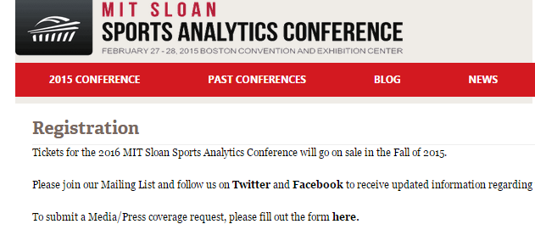
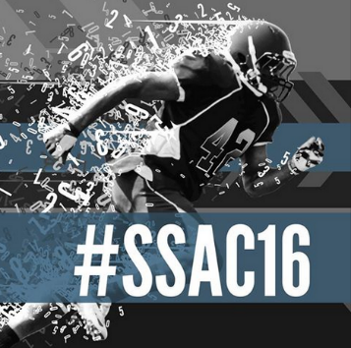
Attend Conferences : USA
MIT SSAC 10th Annual Conference 2016
MIT SSAC runs a hackathon the day before the conference. A synopsis of the conference by the 2015 Student winner of the Hackathon, Shawn Farshchi, a junior from the University of Michigan, appears at http://www.nucksmisconduct.com/2015/3/2/8132011/what-i-learned-at-the-sloan-sports-analytics-conference
Notes:
The MIT event is wonderful – try to attend if you can

Slide 13
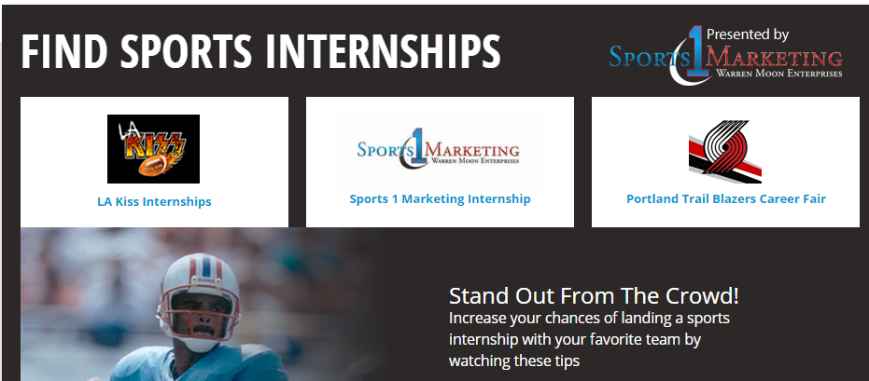
Try for an Internship
http://www.sportsinternships.com/
http://www.internships.com/sports
Notes:
here are a couple of sports internship websites that might be useful. Note that it may be possible for your students to ally with the sports teams at your schools, and create an internship by getting to know their needs. Many schools have MBA Clubs focusing on sports analytics that serve this function.

Slide 14

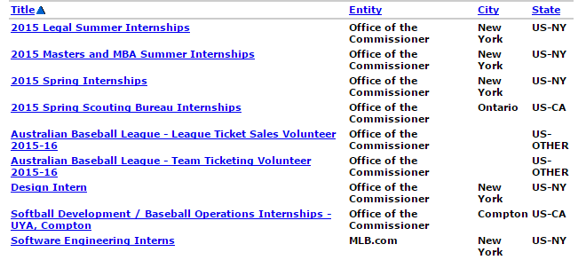
Try for Internships with a League
Source:
Notes:
the major leagues have summer internship positions. This is just the one for MLB - In Australia, where they are trying to expand. You might ask students to take a look at job boards across the various sports fields and report back on what they find.

Slide 15
Try for an Internship with Sports Ad Spenders
TV sports advertising is dominated by a few big spenders, with the top 10 — led by AT&T, Bud Light, Verizon Wireless, McDonald’s and DirecTV—accounting for roughly a quarter (26%) of the total spend.
While it is difficult to get a job with a sports team, you may be able to get a job with the group in any big advertiser that does ad placements and help them understand the impact of their spending
Source: : Source: http://www.forbes.com/sites/mikeozanian/2012/05/16/biggest-spending-sports-tv-advertisers-give-shareholders-little-to-cheer-about/
Notes:
another job possibility is to try to get a job with a consumer-products group that has a healthy spend in sports venues. You could ask students to go take a look at who are the biggest sponsors of local sports, who are the biggest advertisers on the TV stations in your market, etc.

Slide 16
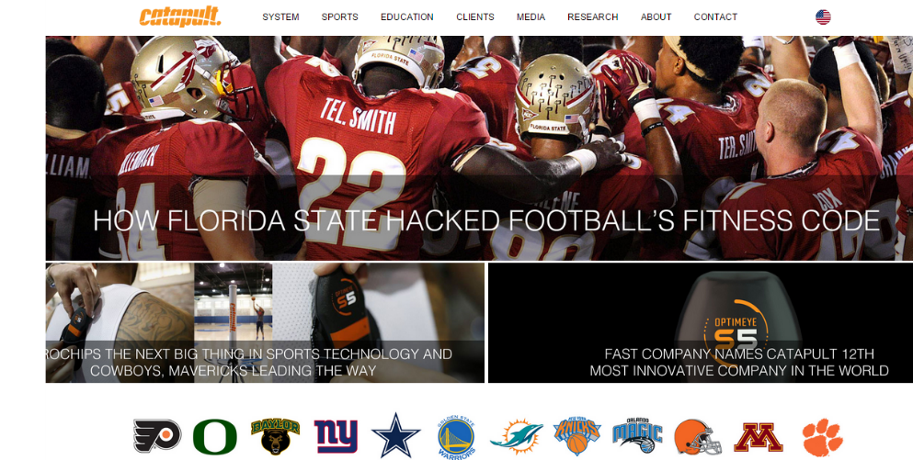
Read Vendor Websites - Catapult
Source: http://www.catapultsports.com/
Notes:
wearables vendors are another possibility, since they will hire students who turn into analysts for rent, or even sales people with analytics skills. Exploring their websites (and others, like Nike) for internships is another good way to learn what’s possible

Slide 17

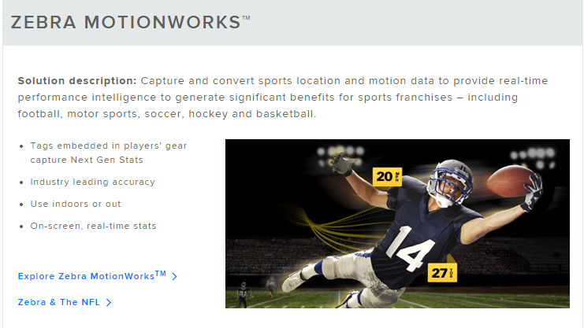
Read Vendor Websites - Zebra
Source: https://www.zebra.com/us/en/solutions/location-solutions/sports-tracking.html

Slide 18
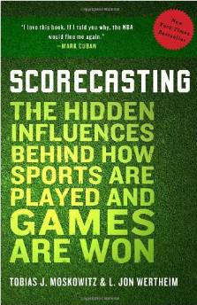
Best Book I’ve Found
From AMAZON.com:
In Scorecasting, University of Chicago behavioral economist Tobias Moskowitz teams up with veteran Sports Illustrated writer L. Jon Wertheim to overturn some of the most cherished truisms of sports, and reveal the hidden forces that shape how basketball, baseball, football, and hockey games are played, won and lost.
Source: http://www.amazon.com/Scorecasting-Hidden-Influences-Behind-Sports/dp/0307591808
Notes:
you may want to buy, or recommend to students that they buy and share these books. I’ve already recommended the Scorecasting book.

Slide 19

Best Book On Soccer
From AMAZON.com:
Moneyball meets Freakonomics in this myth-busting guide to understanding—and winning—the most popular sport on the planet - now with a new afterword on the 2014 World Cup! Innovation is coming to soccer, and at the center of it all are the numbers—a way of thinking about the game that ignores the obvious in favor of how things actually are. In The Numbers Game, Chris Anderson, a former professional goalkeeper turned soccer statistics guru, teams up with behavioral analyst David Sally to uncover the numbers that really matter when it comes to predicting a winner. Investigating basic but profound questions—How valuable are corners? Which goal matters most? Is possession really nine-tenths of the law? How should a player’s value be judged?—they deliver an incisive, revolutionary new way of watching and understanding soccer.
Source: http://www.amazon.com/Scorecasting-Hidden-Influences-Behind-Sports/dp/0307591808
Notes:
I know that many international students are interested in soccer, and this book is fascinating. One of the authors, Chris Anderson has presented often at MIT events. You might ask the students to Google him to find out more.

Slide 20
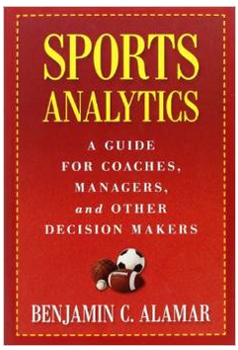
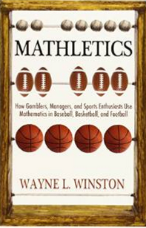
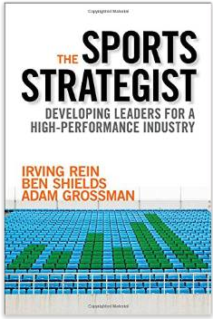
Other Recommended Sports Analytics Books
Notes:
The Sports Analytics book is interesting because it’s written from the viewpoint of a person who knows data warehousing. The Mathletics book is very hands-on, including Excel data set access, but mostly focused on statistics, not predictive models. Still, these are also important topics to know and there are many, many examples. The Sports Strategist book takes the point of that winning is not the main factor in making money in sport, and that there are other, more controllable aspects to building a good franchise. It’s a wider survey book than the others.

Slide 21
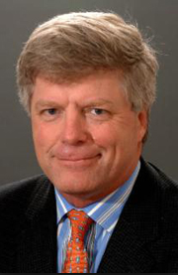
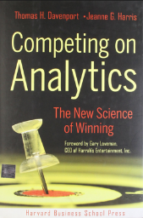
What to Read? Best Paper
Beautifully written by the leading expert on Analytics
Thomas Davenport, “Analytics in Sports: The New Science of Winning”, International Institute for Analytics White paper, sponsored by SAS, Feb 2014.
Source: http://www.sas.com/content/dam/SAS/en_us/doc/whitepaper2/iia-analytics-in-sports-106993.pdf
Notes:
as I highlighted numerous times, this Tom Davenport paper is basic reading for anyone in this area. You might suggest they re-read it as a conclusion to this sports analytics module and maybe pick one topic that they want to explore much deeper, maybe as part of a directed study program.

Slide 22
Summary 6 Key Topics
Sport is Big Business
The field of Sports Analytics is hot
Sports Analytics apply to Business Operations
Sports Analytics apply to Team Operations (new opportunities from video and sensor data)
Analytics are also used across all sports for training, health and safety
Tips on getting a job in sports analytics
Notes:
is an overview of the flow of the topics across the various modules. You will need to read the other Modules and Teaching Notes before you present this.

Slide 23

About the Author
Dr. Dave Schrader worked for 24 years at Teradata, a
leading high-tech vendor of parallel data warehouses.
His positions included Director of Engineering – Advanced Development and Director of Marketing. In both positions, he built presentations for customers and faculty/students on leading-edge topics like Big Data Analytics, Active Data Warehousing, and Best Practices for Customer Management.
Although he retired in 2014, he has remained on the Teradata University Network Board of Directors, contributing materials for faculty and students to learn about new topics – like sports analytics.
I hope you enjoyed this deck! Contact me at drdaveschrader@gmail.com with your comments or questions.
Notes:
in case you want to get in touch with me! Always looking for collaborators.

